Slide 1
Chapter 3
Exponential and Logarithmic Functions
© Pearson Education Limited 2012

Slide 2
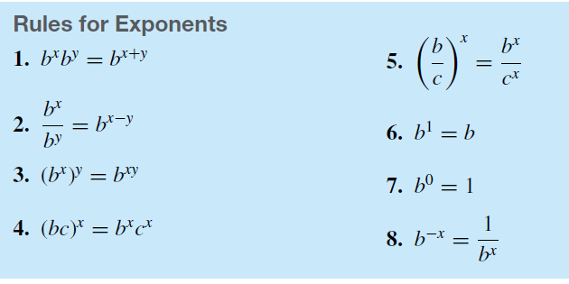
3.1 Exponential Functions
The function f defined by
where b > 0, b ≠ 1, and the exponent x is any real number, is called an exponential function with base b.

Slide 3
y = log_{b}x if and only if b^{y} = x
The difference between natural logarithmic and common logarithmic
The domain of a logarithmic function is the interval (0,∞)
The range of a logarithmic function is the interval (-∞ , ∞)
The base of the logarithmic can’t be negative number

Slide 4
Example 14 – Converting from Exponential to Logarithmic Form
Exponential Form Logarithmic Form
Since 5² = 25 it follows that log₅25 = 2
Since 3⁴ = 81 it follows that log₃81 = 4
Since 10⁰ = 1 it follows that log₁₀1 = 0

Slide 5
Converting from logarithmic to exponential form
Log₁₀1000 =3 means 10³ = 1000
Log₆₄ 8 = 1/2 means 64^{1/2} = 8
Log₂ 1/16 = -4 means 2⁻⁴ = 1/16

Slide 6
Solving logarithmic equations
Find:
a. Log₂ x = 4
2⁴ = x
X = 16
b. Ln (x+1) = 7
e⁷ = x+1
X = e⁷-1
c. Log _{x} 49 = 2
x² = 49
x = 7 or x = -7
We reject x = -7 because a negative number can not be a base for a logarithmic function

Slide 7
Chapter 3: Exponential and Logarithmic Functions
3.2 Logarithmic Functions
Example 18 – Finding Logarithms
Find log100
Solution:
Find ln1
Solution:
Find log0.1
Solution:
Find lne^{–1}
Solution:
Find log₃₆6
Solution:

Slide 8
b ^{log}_{b} x = x
e ^{ln} ^{x2} = x²
----------------
10 ^{log} ^{x2} = 25
x² =25
X=±5

Slide 9
3.3 Properties of Logarithms
Properties of logarithms are:

Slide 10
Example 23 – Finding Logarithms by using Table 3.4
a. Find log56 Solution:
Find Solution:

Slide 11
Example 23 – Finding Logarithms
Find log64 Solution:
Find Solution:

Slide 12
Chapter 3: Exponential and Logarithmic Functions
3.3 Properties of Logarithms
Find
Solution:
b. Find
Solution:
c. Find
Solution:
d. Find
Solution:
e. Find
Solution:

Slide 13
Write in a single Logarithms:
Ln 3 +ln7 – ln2 – 2ln4
=ln3+ ln7 – [ln2 + ln (4)² ]
=ln (3 . 7) – ln (2. 16)
= ln 21 – ln 32
= ln 21/32

